Slide 1

PC649 - Summer Internship Report
Resume Ranker - AI Powered Recruitment
By: Kishan Thanki

Slide 2

Resume Ranker: AI-Powered Recruitment
The Resume Ranker is an AI-powered designed to automate and enhance resume screening, addressing the challenge recruiters face in efficiently evaluating large volumes of resumes.

Slide 3
Objective & Key Requirements
1
2
3
Simplify Evaluation
Functional Needs
Non-Functional Needs
Structured parsing, intelligent matching, and multi-factor scoring improve hiring efficiency.
Resume/Job Description parsing, ranking algorithm (skills 50%, text 30%, experience 20%), API & Frontend.
Performance (<3s parsing), Accuracy (94% skill matching), Scalability (hundreds of resumes).

Slide 4
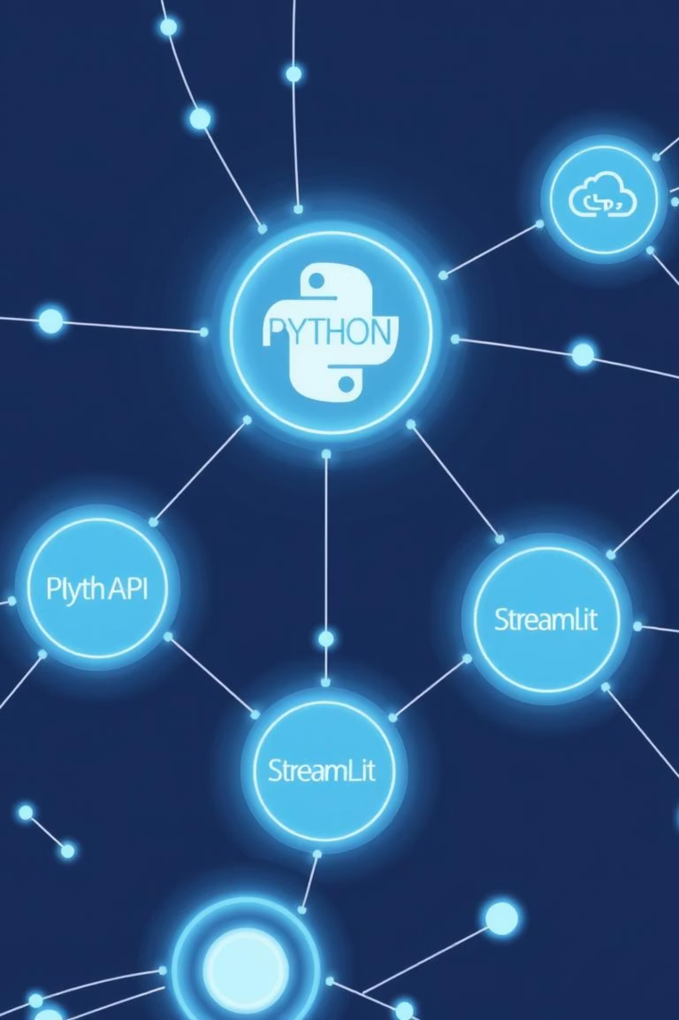
Technology Stack & Features
Tech Stack
Key Features
Backend: Python, FastAPI (REST API), SQLAlchemy (ORM), SpaCy (NLP)
Resume parser with 7 skill categories.
Weighted multi-factor similarity scoring.
Frontend: Streamlit (recruiter UI)
API Endpoint for detailed resume analysis.

Slide 5

Methodology & Processes
The project used an iterative development process, inspired by Agile methodology, with focused sprints.
Requirement Gathering
Design: Data models and scoring logic.
Development: Incremental feature building.
Testing: Module and API

Slide 6


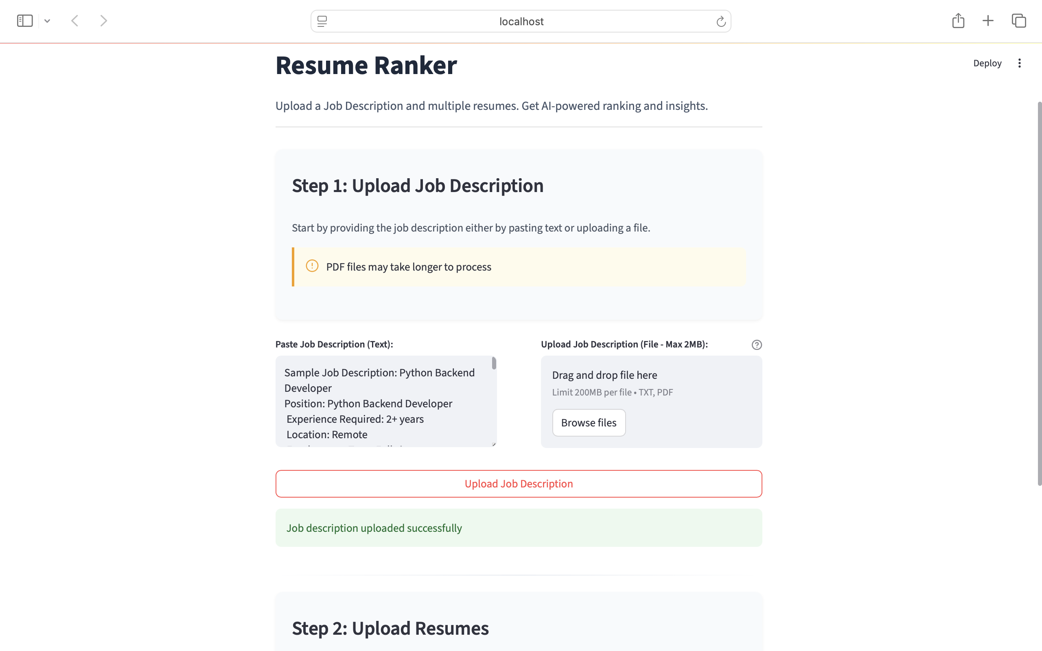
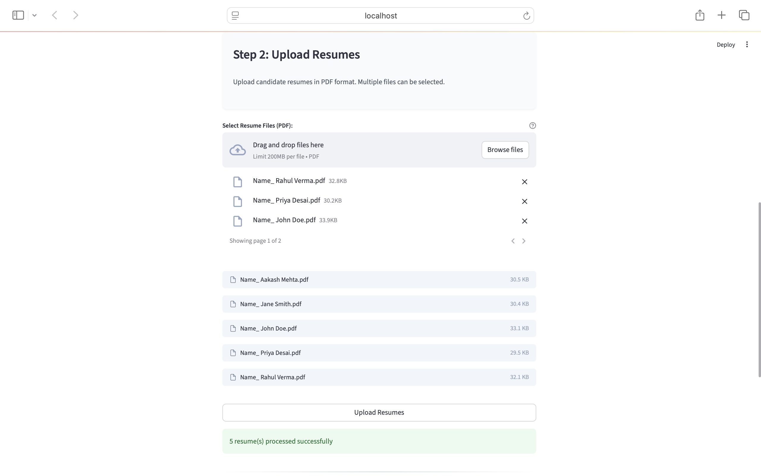
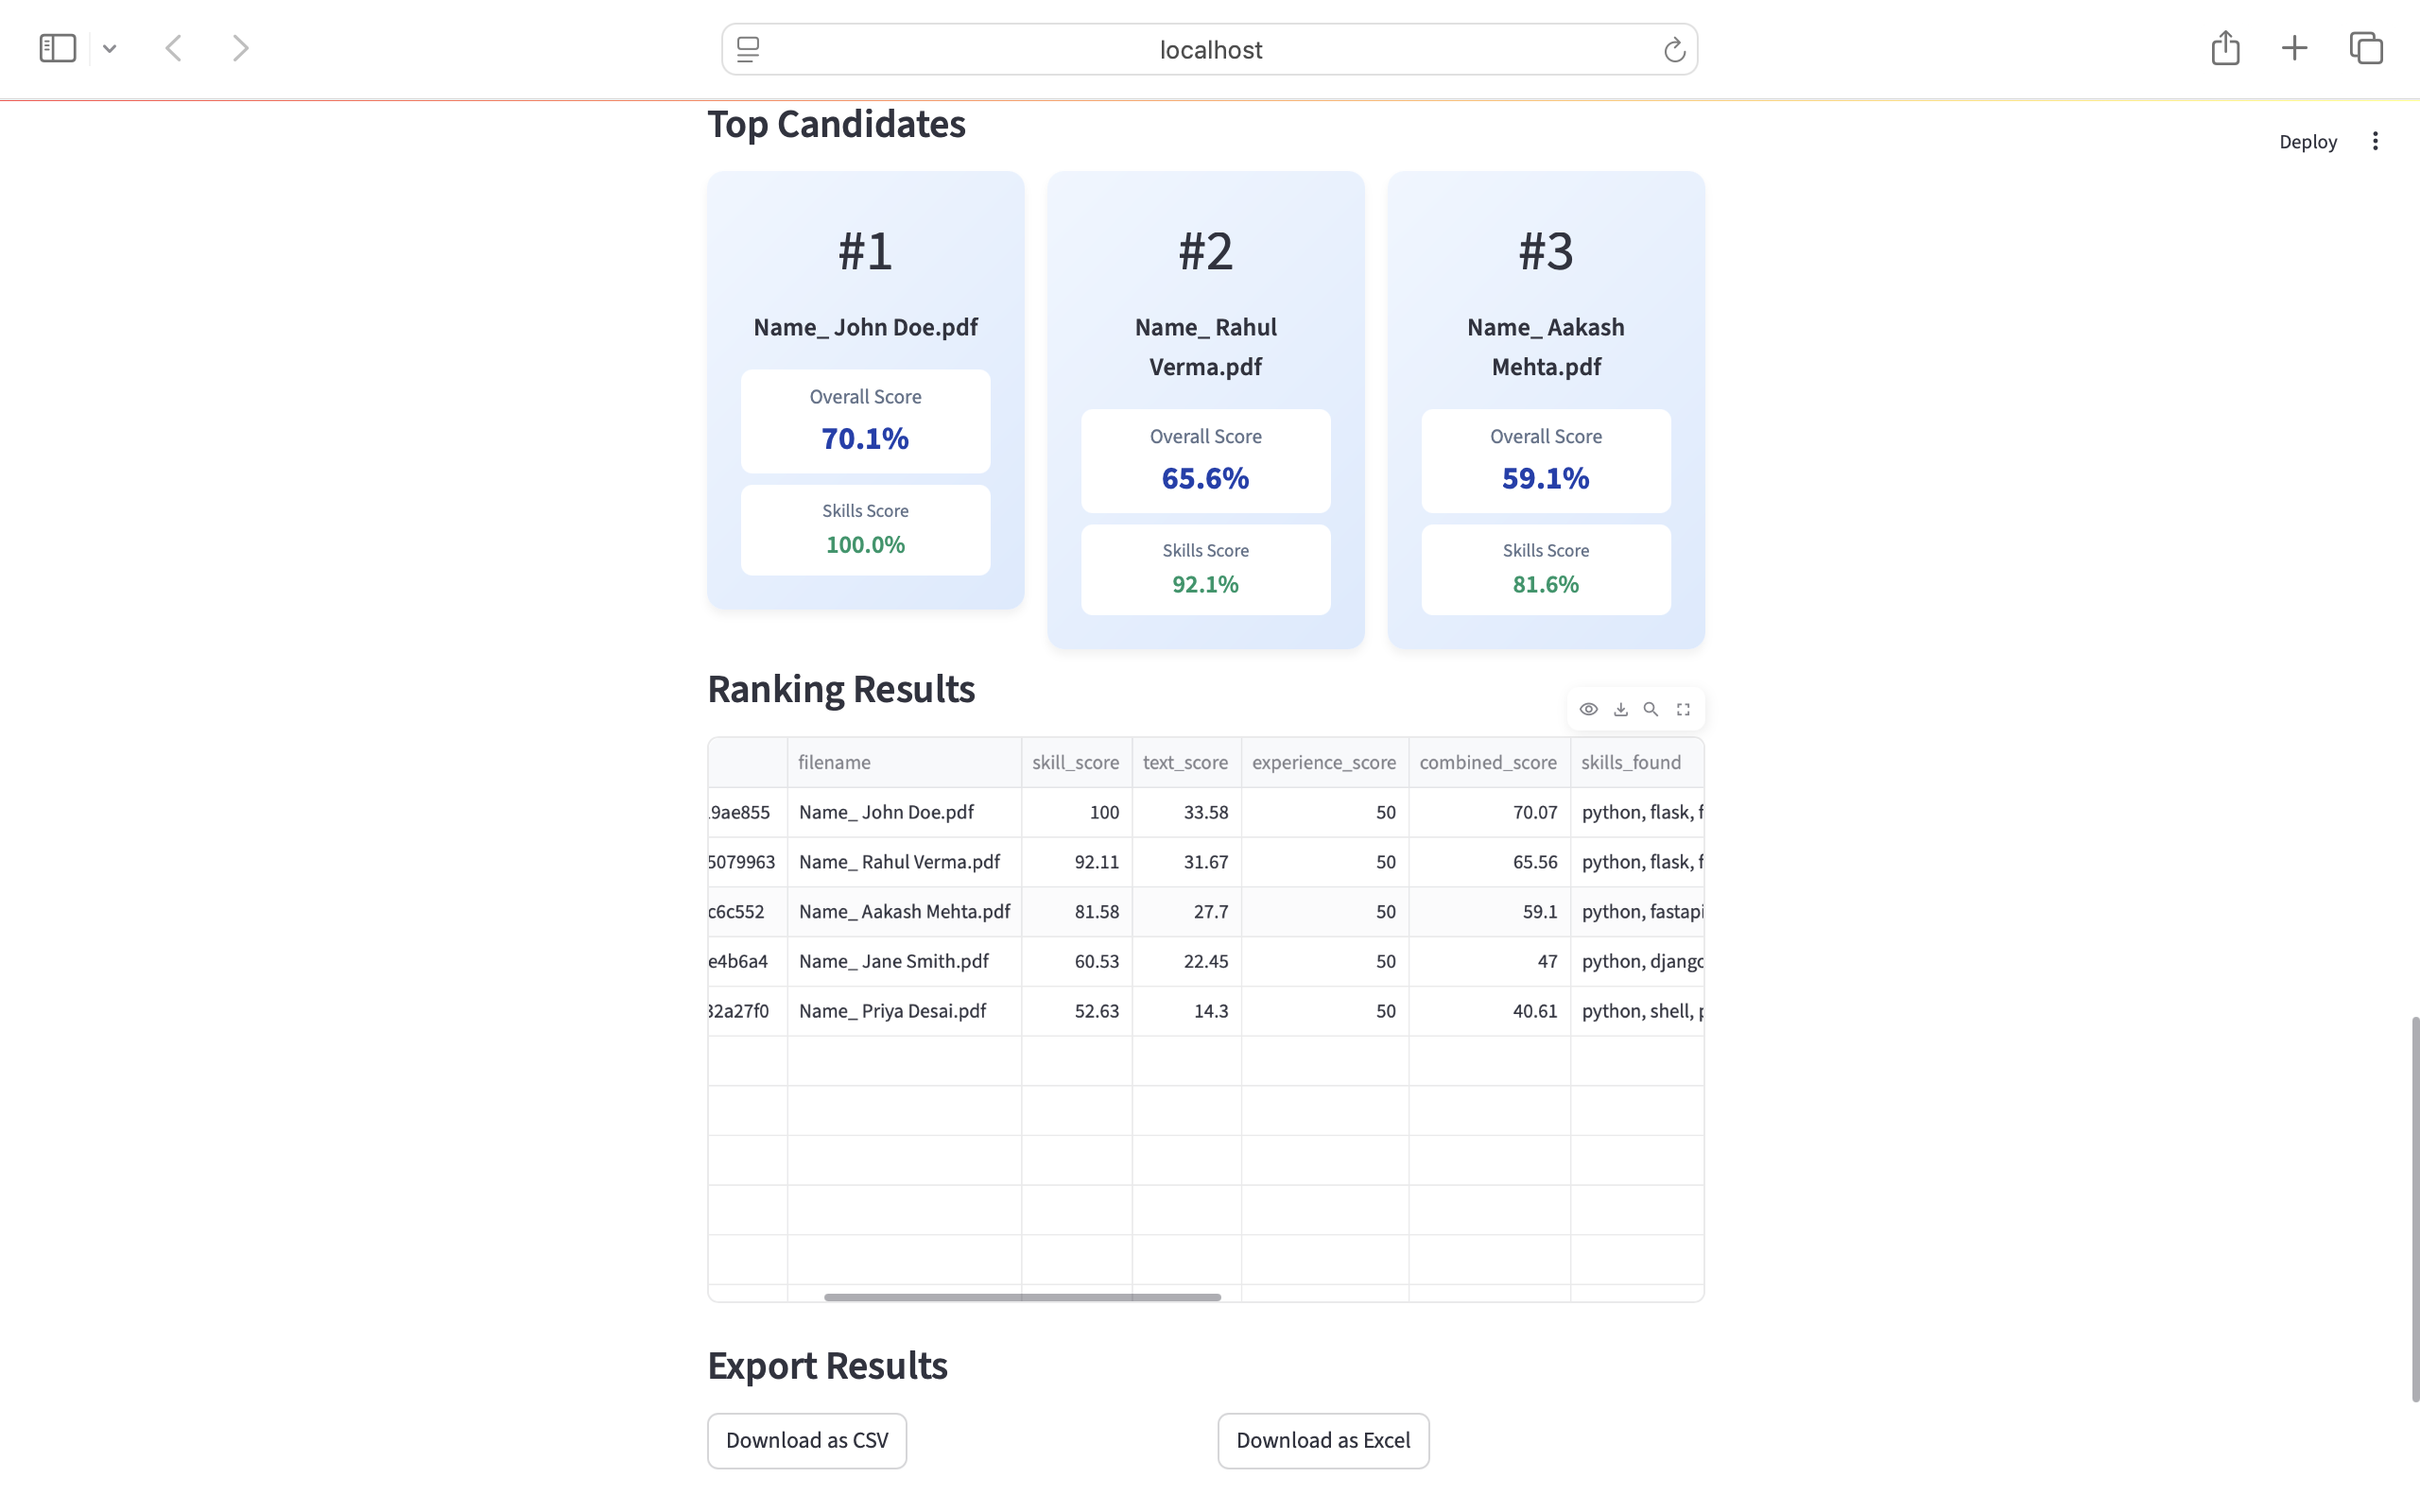
Snapshots & Links
Explore the Resume Ranker in action:

Slide 7
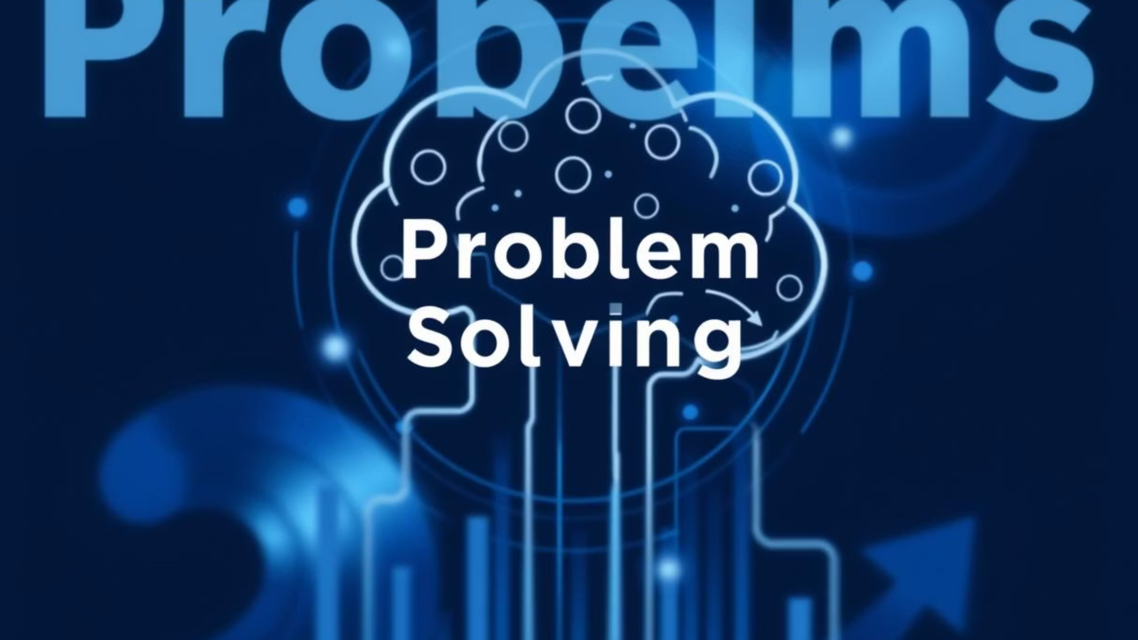
Challenges & Solutions
Parsing Diversity
Algorithm Weighting
Skill Accuracy
Accurately parsing diverse resume formats and layouts was addressed by leveraging robust NLP libraries (SpaCy)
Defining and effectively weighting the scoring algorithm was achieved through iterative refinement based on feedback and validation.
Ensuring accuracy in skill extraction and matching involved using comprehensive predefined skill sets and continuous refinement of skill mapping logic.

Slide 8
Conclusion & Future Scope
The Resume Ranker significantly streamlines the recruitment process, offering a powerful AI-driven solution for efficient and objective candidate evaluation.
Future Enhancements:
Integration with Applicant Tracking Systems (ATS).
Advanced NLP for sentiment analysis or soft skill detection.
Machine learning models for continuous improvement of ranking accuracy.
User customization of scoring weights and skill categories.
Support for additional document formats and languages.

Slide 9
Thank You

